Slide 1
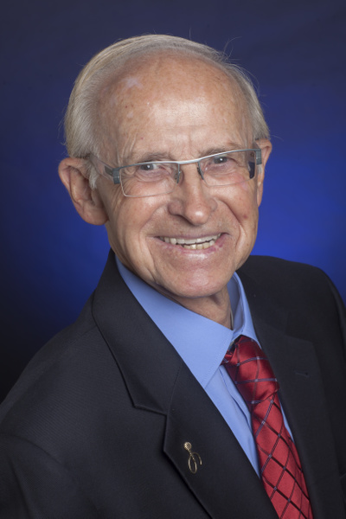
Live Your Live According to Your Vision for your Life!
Gary McKinsey
Add a powerful testimonial quote about what you audience will get from your session! Make it one that SELLS what you have to offer.
Business Marketing
Strategist
email:Gary@GaryMcKinsey.com
Web-sites:GaryMcKinsey.com
Phone:209-345-4230
-- happy audience member
YouTube
Speaking Topics
Bio
Keys to Increasing Your Productivity.
For over 40 years, Gary has worked with entrepreneurs and businesses to develop and implement marketing plans to attract their perfect clients.
As an introvert, he credits Toastmasters for helping him develop self-confidence,
leadership skills, and, most importantly, the ability to speak in public.
Increase Your Happiness.
Take Control of your life .
Experience Greater Self-Worth.
Winning the Marketing Game.
How to Focus on Your Customer.
Grabbing Your Customer Attention.
Moving Your Customer to Action.
The Language of Influnce.
Identify Your Audience.
Make an Emotional Connection.
Winning Call to Action.
Keynotes,Workshops, & One-on-one Coaching
1 hour workshop
Keynote
Half day seminar
Full day seminar
Proide practical interactive learing experience.
Customizeed to meet youunique organizations goals.
Personalized interactives hands-on programs designed around you outcomes..
Designed a ound your orgnizations needs.
The program is engaging and interactive..

